Slide 1

PC-GNN on Fraud Detection
Group 16
Yahan Cong
Jade Yu

Slide 2

Fraud is around ourselves
Credit Fraud
Spam Emails/comment
Market Fraud
Notes:
As Some of you might have experienced, fraud permeats everywhere in our modern day life, from credit card fraud and spam emails targeting individuals’ financial security to market fraud, which could undermine the market integrity. Therefore, fraud detection is crucial as to protect individuals, businesses and markets. In the recent years, fraud detection with graph structured data, which is named as GNN, has drawn a lot of attention due to its abundant relational information, which is very beneficial for the detection of fraudsters.

Slide 3
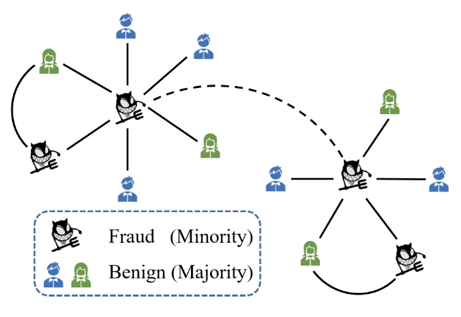
Why we use PC-GNN
Frauds within Normalcy.
Graph Neural Networks prioritize the relationships between targets, focusing on their communal interactions.
GNNs consider targets as nodes, uncovering latent relationships between them to effectively identify fraudulent activities.
Fewer Frauds than Benign: Selective information filter in Groups.
Balancing the Imbalance with PC-GNN
Variant of GNN, emphasizes selective sampling. It constructs relatively balanced sub-graphs by filtering nodes and their neighbors to predict data more accurately.
Notes:
However, the GNN-based algorithms could be really bad when the label distribution of nodes is heavily skewed which is actually common in real life. After all, the number of fraudsters can be far less than that of benign one.
As a result, GNN for fraud detection often suffer from the class imbalance problem and perform poorly especially for the minority but more important class, i.e., the fraudsters.
To address this problem, PC GNN is introduced.

Slide 4
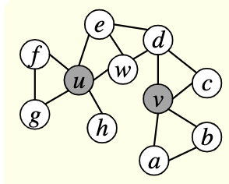
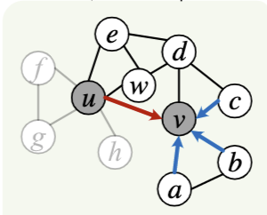
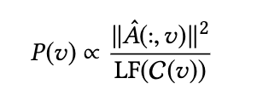
PC-GNN: pick
Pick
Pick-label-Sampler:
To provide a solid starting point for constructing a relatively balanced graph, node selection is strategically based on their labels
Selection Criteria:
Maximizing Minority Class Inclusion
Choose Influential Nodes
Notes:
PC-GNN is design to address the severe imbalance between fraud and benign class, it construct a relatively balanced subgraph in each epoch for every relation.
Firstly, PC-GNN utilizes its pick-label-sampler to randomly select some nodes from the graph as the starting points for subgraphs creation. It follows two principles for selecting nodes: first, It attempts to increase the proportion of minority class, which are the fraud nodes, in the sampling process. As the formula suggests, the fewer fraud nodes in the overall graph, the more likely they are to be chosen. Second, it aims to select nodes with more edges, favoring nodes that are highly connected to enhance the subgraph's representativeness, richness of information, and balance.

Slide 5
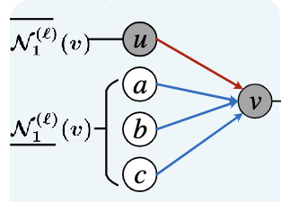

PC-GNN: choose
“Pick” balance the nodes, but cannot balance neighbours for subgraph
Neighbour Sampler: Undersampling and oversampling, balance 1-top neighbour nodes.
Undersampling:
Reduce unnecessary neighbors and cut off their edges
Distance:
Difference between predicted probabilities of node v and node v
UnderSampling of all nodes
Notes:
After the picking step, our subgraph is contrusted by the selected nodes and their 1-top neighbour，however, fraud hidden themselves in normality. Looking at the node v, we can see that we still have too much benign neighbours. The whole subgraph is still unbalanced, and we need to do an undersampling to reduce our unnecessary neighbours by looking at the distance between us. In the formula, h is our learning embedding for node v, and D(h) represent node v’s predicted probabilities. We cut off all our neighbor nodes with significant difference between their prediction and our prediction.

Slide 6

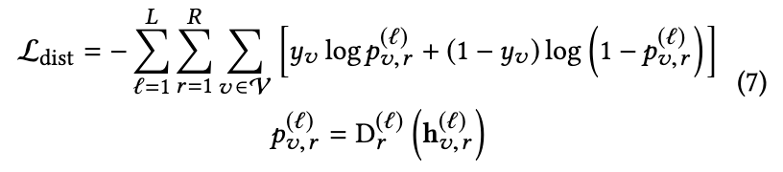
PC-GNN: choose
OverSampling: Only for frauds
Frauds minimize interactions among each other
Creating Connections Between Minority Class Nodes
Neighbor sampling:
Majority class (benign)： undersampling
Minority class (fraud): both undersampling and oversampling.
Learning cross-entropy loss
Now, we get a (relatively) balanced subgraph
Notes:
Except for the overflowing benign neighbours, we still face a problem that fraud will minimize interaction among each other, so even if we have discovered a fraud’s network pattern, it is still hard to utilize it find another fraud because lack edges makes the information vague during information exchange. Node v is a clever fraud, hidden himself in benign, and never connect directly with fraud u. If we want to learn from node u, information needs to pass through at least w and d, the learned information may no longer represent u’s network pattern well. So we want to create connections manuly between the fraud nodes. We search on all the fraud nodes in our subgraph, and if any of their predicted probability difference is small than our threshold, we add them into the current fraud’s neighbour list as oversampling neighbour. After create the red edge between u and v, we can learn from u much easily and correct. So after the undersampling and oversampling, we get a relatively balanced graph.

Slide 7
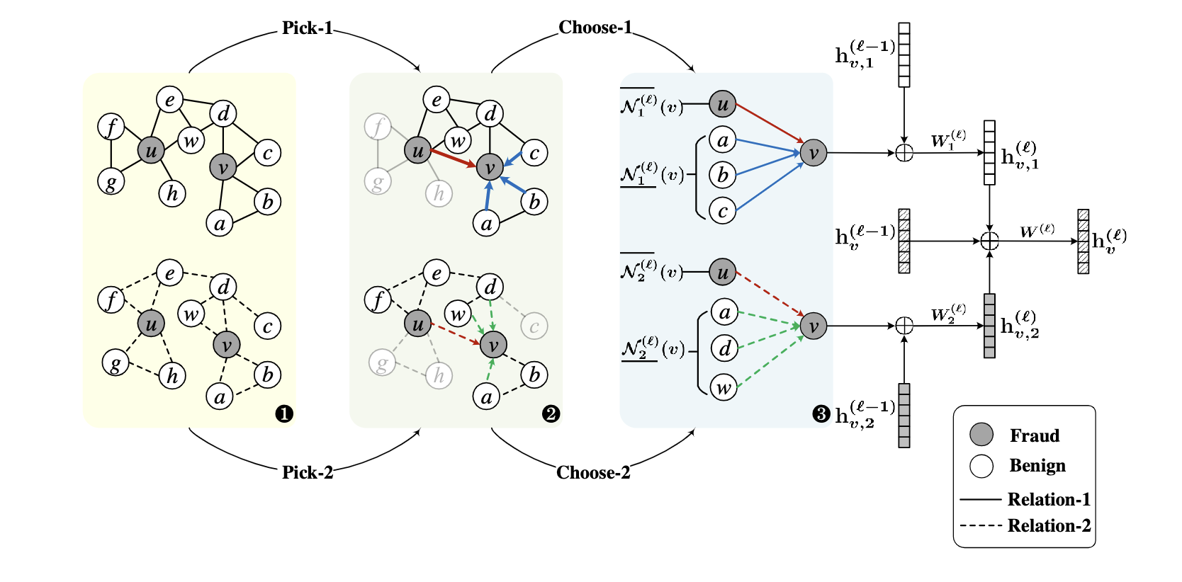
PC-GNN: Learn and Aggregate
Notes:
We have already shown how to pick and choose in a single relation. In the whole training graph, we have multiple relations, and we create relatively sub-graphs for each of them.

Slide 8
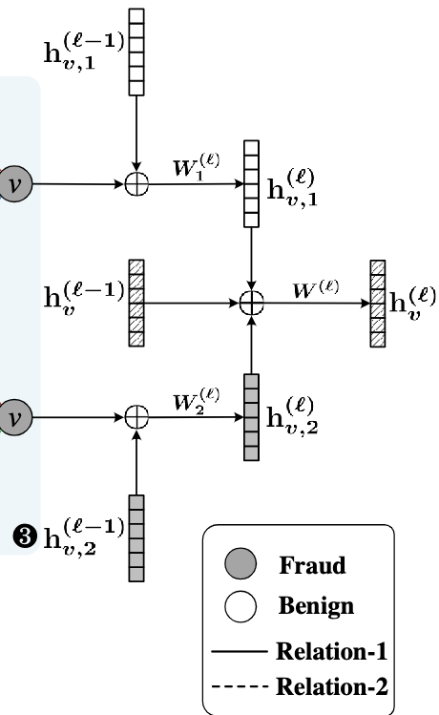


PC-GNN：Aggregate
Multiple relations in the graph
Aggregate learnt embedding about one relation.
Aggregate all learnt embedding among relationships.
Notes:
The final methodology part is how we aggregate information in PC-GNN. Firstly, we concatenate node’s previous learnt embedding with the mean of its neighbour previous learning for one relation. After single relationship information aggregation, we concatenate it with node’s learnt embedding on other relationship. We get the PC-GNN’s binary classification result by transfer the final hvL by an MLP（Multilayer Perceptron).

Slide 9

Research Question
Whether PC-GNN has better performance on fraud classification
Compare the performance of PC-GNN across varied graph structure data
Fine tune the hyperparameters of the model to achieve best detection results
Three real world datasets：
Yelpchi：Relation-Driven Graph Construction
FDCompCN: Behavior-Linked Graph Construction
AlibabaLoan: Attribute-Sharing Graph Construction
Notes:
In this project, we have three research questions.
The three datasets that we applied on both traditional GNN model and PCGNN.
yelp, classic benchmark dataset, we want to detect fraud positive reviews on Yelp for around 70 thousand reviews for hotels and restraurants in Chicago. In this dataset, there exist less than 14% filtered fake reviews by around 20% spammers.
FDCompCN, real world dataset for detecting financial statement fraud of companies in China. Raw data is obtained from the China Stock Market and Accounting Research database. We select samples between 2020 and 2023, including 5,317 publicly listed Chinese companie. Fraud proportion is around 10%.
Alibaba Loan data, we selected 7 thousand samples from the loan dataset from Alibaba Cloud Tianchi, containing borrower information and loan-related details, the size of which is 80 thousand. fraud rate is only around 20%. We used DGL library to construct a graph structure out of it.

Slide 10
PC-GNN on YelpCHI
Preprocessed natural language features related to Chicago restaurant and hotel reviews.
Nodes: Reviews on yelp
Relation-Driven Graph Construction, three relationships inside:
RUR: Review – User- Review
RSR: Review – Same product - Review
RTR: Review – Same product & Same month - Review
Model | F1-macro | AUC | GMean
GCN | 0.5049 | 0.5628 | 0.2274
GraphSAGE | 0.5650 | 0.7603 | 0.6943
PC-GNN | 0.6871 | 0.8182 | 0.7216
Notes:
As we see here, PC GNN has greater performance than traditional GNN models, GCN and Graphsage.

Slide 11
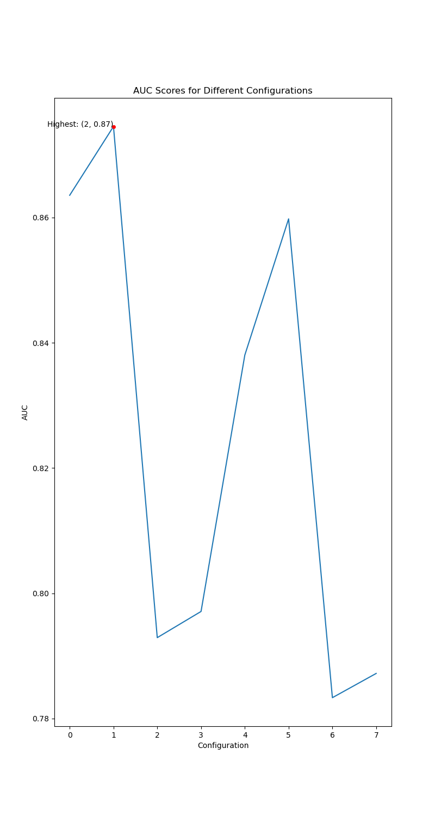
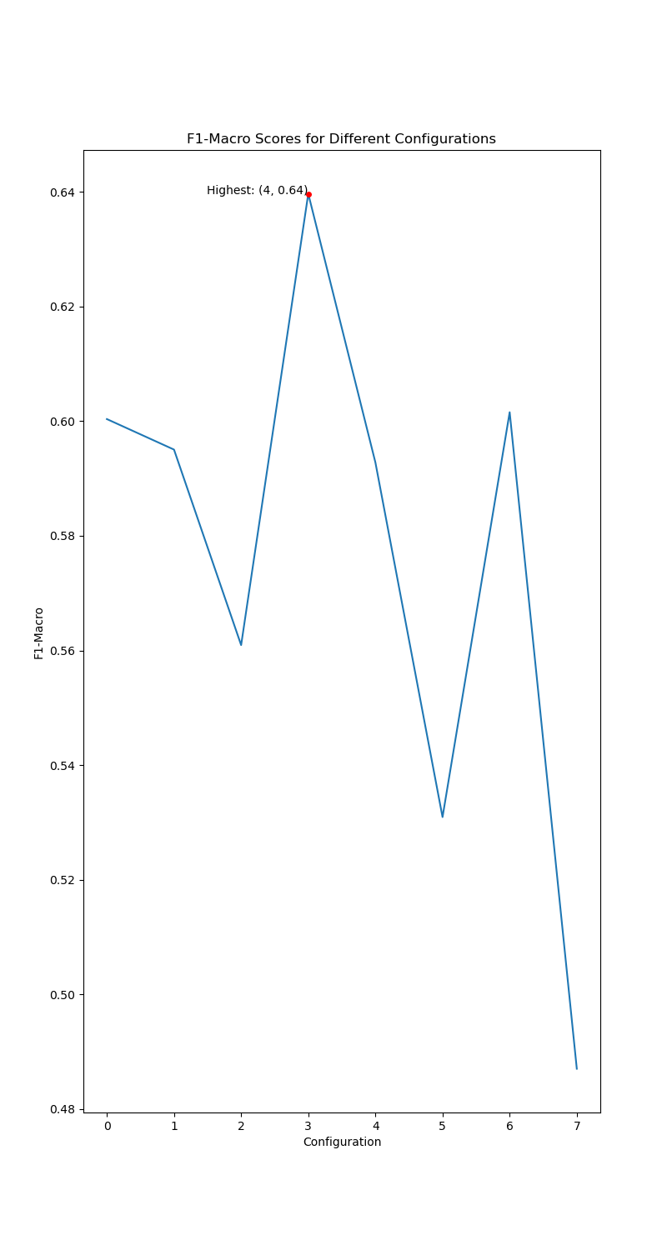
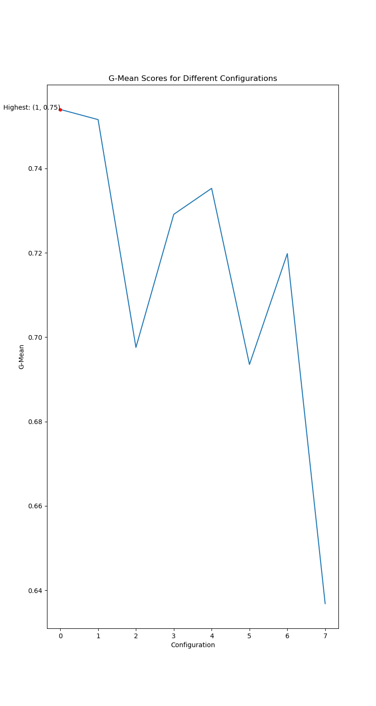
Notes:
And we tried to fine tune the hypermeters and the result is pretty promising.

Slide 12
PC-GNN on FDCompCN
Preprocessed fundamental and financial statement data of listed companies from Shanghai, Shenzhen, and Beijing in China.
Nodes: Company
Behavior-Linked Graph Construction, three relationships inside:
CIC：companies that have investment relationships.
CPC: companies and their disclosed customers.
CSC: companies and their disclosed suppliers.
Model | F1-macro | AUC | GMean
GCN | 0.29 | 0.59 | 0.45
GraphSAGE | 0.3583 | 0.7055 | 0.5475
PC-GNN | 0.5425 | 0.7829 | 0.6811
Notes:
From fraud company dataset, we see that PC GNN is still superior.

Slide 13
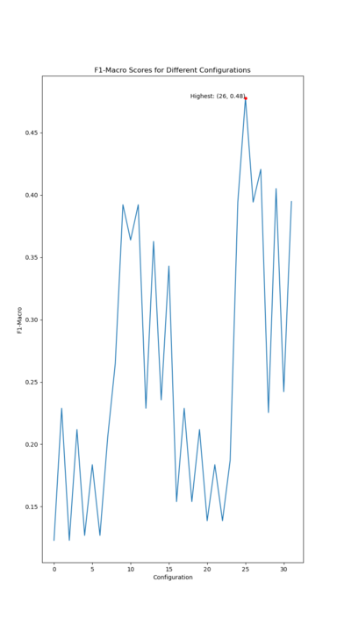
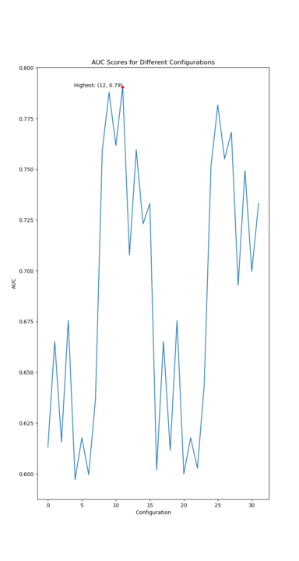
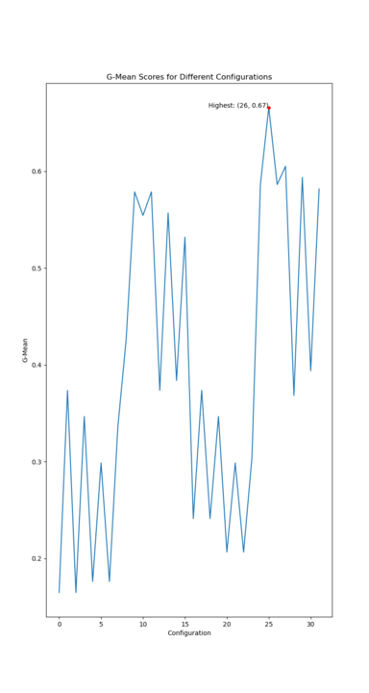
Notes:
And the fine tuning process is smooth as well

Slide 14
PC-GNN on AlibabaLoan
Preprocessed loan dataset from Alibaba Cloud Tianchi, containing borrower information and loan-related details.
Nodes: Loans
Attribute-Sharing Graph Construction, four relationships inside:
TAT: Loan information with similar amounts.
TGT: Loan information with the same credit rating.
TPT: Loan information with the same purpose.
TRT: Loan information from the same region.
Model | F1-macro | AUC | GMean
GCN | 0.16 | 0.5416 | 0
GraphSAGE | 0.16 | 0.65 | 0
PC-GNN | 0.3225 | 0.6677 | 0.4104
Notes:
However, when it comes to the third dataset. We see a drop in performance. This could be due to several reasons, which we are still exploring.

Slide 15
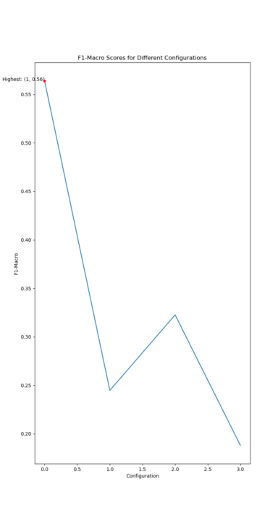
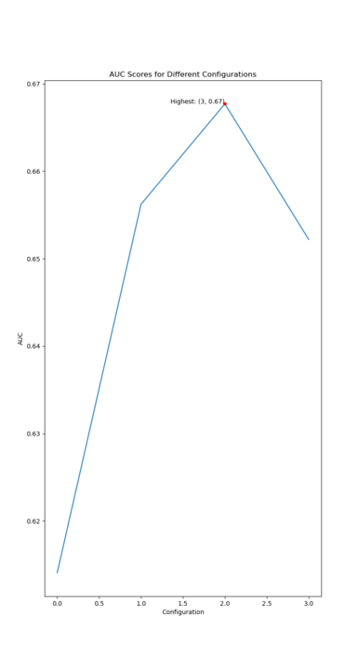
Notes:
Even after fine tuning

Slide 16
Conclusion
Notes:
PCGNN is clearly superior than traditional GNN models. It addresses the real world problem of class imbalance and achieved great performance on several datasets.

Slide 17
Future Work
Fine tuning
How to improve model result when fraud rate is too low
Notes:
To wrap it up, our future work include go through more fine tuning configurations and figure out methods to further address the problem of extreme class imbalance.

Slide 18
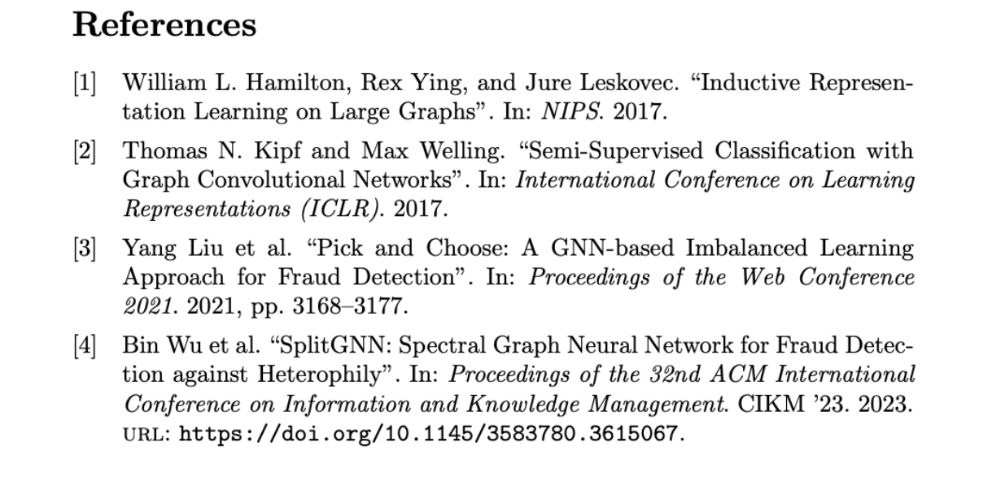
Reference

Slide 19
Thank you

